Slide 1
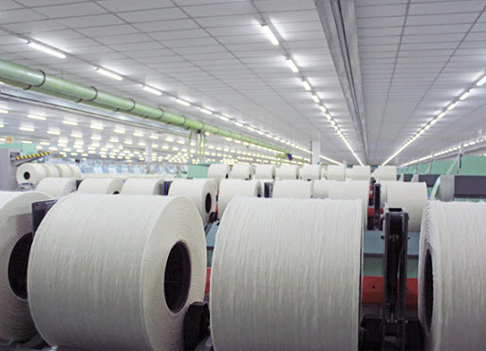
DAMSAN JSC.
HOSE: ADS
Address: Lot A4 - Bui Vien Street - Nguyen Duc Canh Industrial Park - Thai Binh City
Website: http://damsanjsc.vn/

Slide 2
PART I: MACROECONOMIC & VIET NAM TEXTILE INDUSTRY OVERVIEW
CONTENT
PART 2: COMPANY OVERVIEW
PART 3: FINANCIAL HIGHLIGHTS
PART 4: STOCK SNAPSHOT
| Presentation

Slide 3
PART I: MACROECONOMIC & VIET NAM TEXTILE INDUSTRY OVERVIEW
| Presentation

Slide 4
MACROECONOMIC
GDP is still growing positively, highest in the period of 2011-2022, while Inflation remain slight high at approx. 4% for 9M 2022
Processing and manufacturing industry attracts large amount of registered FDI
Population increases, leading the demand of Textiles
(Unit: billion people)
Sources: VCOSA and GSO
| Presentation

Slide 5
VIETNAM TEXTILE INDUSTRY
Vietnam's Fabric and Garment export value increased over the same period
Vietnam's Yarn export Quantity remain stable; however, value decrease a little due to slightly price reduce
Sources: VCOSA and GSO
| Presentation
Notes:
https://www.slideshare.net/VietnamCottonandSpin/vcosa-bo-co-thng-k-cp-nht-ngnh-bng-si-thng-62021%C2%A0

Slide 6
PART II: COMPANY OVERVIEW
| Bài thuyết trình

Slide 7
II. COMPANY OVERVIEW
1. DEVELOPMENT MILESTONES
2006
2009
2010
2011
2013
2014
2015
2016
2019
2021
2022
TRADING DATE
The first trading day on Ho Chi Minh City Stock Exchange (HOSE) with the stock ticker ADS
INVESTMENT
Into EIFFEL yarn factory with total investment of 300 billion dong with a scale of 40.000 piles of yarn
DAMSAN BUILDING
Constructed Damsan 15 floor building with 286 apartments at a total value of 150 billion dong
ESTABLISHMENT
EIFFEL Yarn Joint Stock Company
ROAD CONSTRUCTION project From Thai Binh city to Nghin bridge
ESTABLISHMENT
AD Green Energy Group Joint Stock Company
AN NINH YARN FACTORY
2.6ha worths 320 billion dong
FACTORY MANUFACTURING SOLAR BATTERIES
7.9ha worth 600 billion VND
ESTABLISHMENT
Damsan Textile Joint Stock Company was established by Thai Binh Investment Trading JSC. and members of the Handicraft Import-Export company.
Commencement of construction of Damsan I factory
INVESTMENT IN NEW FACTORY
Damsan II factory, total investment of 10 million USD with a capacity of 3,600 tons of OE yarn/year and 720 tons of towels/year in Thai Binh province
PUBLICIZATION
30 May 2021, approved by the State Securities Commission to become a public company according to Official Letter No. 1566/UBCK-QLPH
FIRST INDUSTRIAL CLUSTER
An Ninh Industrial Cluster with total area of 75ha worths 320 billion dong
PRIZE
Won the title "Vietnamese Golden Enterprise" by the Vietnam Association of Small and Medium Enterprises
PRIZE
was awarded the Vietnam Gold Star Award and the title of Top 100 Vietnamese Brands in international integration.
FIRST BUILDING
Constructed first 18 floor building with 262 apartment at a total value of 134 billion dong
Vision
Mission
We apply an advanced, environment-friendly technology, modern management, professional team and with an innovative and progressive culture, through reducing consumption of resources, energy to protect the environment and contribute to the society and bring the community modern and friendly products and services. The middle and low-income classes are the center.
To become a leading global enterprise in the yarn/textile industry and develop multi-industry with the core of textile and real estate
| Presentation

Slide 8
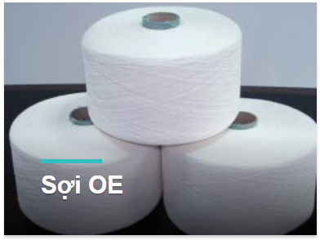
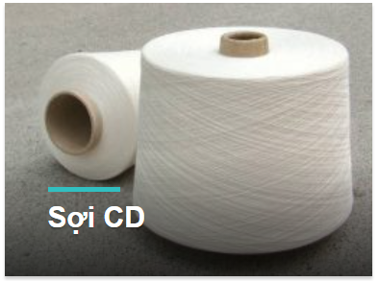
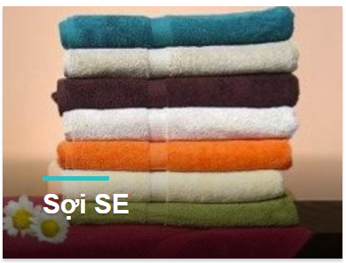
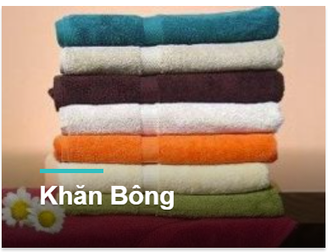
II. COMPANY OVERVIEW (Cont)
2. MAIN BUSINESS ACTIVITIES
PRODUCTION OF FIBER AND TOWEL - MODERN PRODUCTION LINE
 | INFORMATION | DAM SAN I FACTORY | DAM SAN II FACTORY | EIFFEL FIBER FACTORY | FACTORY FOR FIBER AND TOWEL PRODUCTION
INVESTMENT INFORMATION | Technology and Machine | Germany and Switzerland | Germany and Switzerland | Germany and Switzerland | Europe
 | Location | Nguyen Duc Canh Industrial Park, Thai Binh province | Gia Le Industrial Park, Dong Hung Dist.,Thai Binh province | Gia Le Industrial Park, Dong Hung Dist.,Thai Binh province | An Ninh Industrial Zone
 | Land Area | ~ 23,000 sq. m | ~ 36,000 sq. m | ~ 24,000 sq. m | ~ 3,500 sq. m
 | Total Investment Capital | ~ 230 billion VND | ~ 162 billion VND | ~ 350 billion VND | ~ 400 billion VND
 | Year of Investment | 2006 | 2009 | 2015 | 2021
PROJECT ÌNORMATION | Expected output​​ | ~ 3,900 tons of yarn/month | ~ 1,800 tons of high end towel/year | ~ 7,200 tons of CD32/month | 42,000 tons of yarn and 150 modern sewing machines
 | Product | Cotton of all kinds | High-end towel of all kinds | Cotton of all kinds | Yarn and towel
 | Export market | Korea, Japan, China, Taiwan | Korea, Japan | China
| Presentation
Notes:
Thêm các thông tin về sản phẩm, nhà máy…

Slide 9
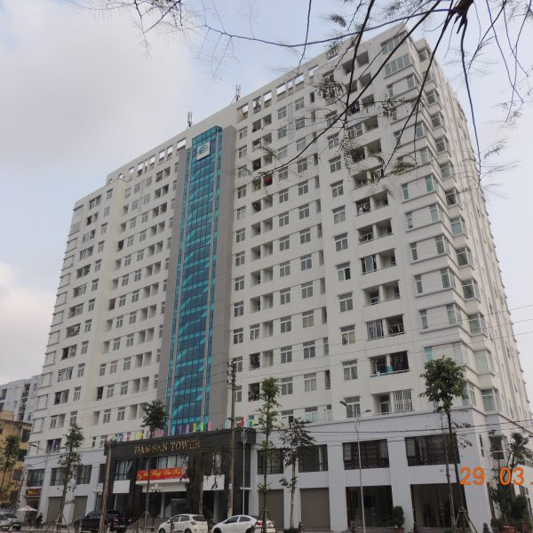
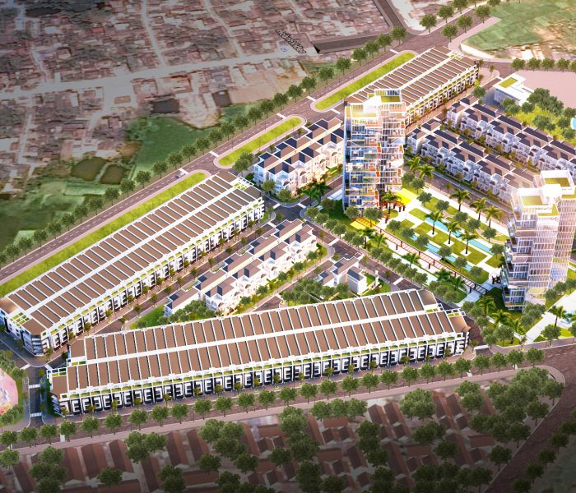
II. COMPANY OVERVIEW (Cont)
3. RESIDENTIAL REAL ESTATE
4. COMPLEX RESIDENTIAL PROJECT
HANDED OVER
UNDER DEVELOPMENT
DAMSAN QUANG TRUNG TOWER
Location | Quang Trung Ward – Thai Binh Province
Overview | 15 floor – 286 units
Type | Social houses
Total investment capital | 150 billion VND
Handed over since | 2017
PHU XUAN DAMSAN RESIDENENCES
Location | Ly Bon street, Thai Binh province
Overview | 76 villas (from 3 – 4 floors ) – with neoclassical architecture; 246 shophouses (from 4 – 5 floors) Facilities and Amenities: green park, sports ground, children's cultural house and kindergarten.
Land Area | 105,000 sq. m
Expected Handed over date | 2021 - 2023
| Presentation
Notes:
Yêu cầu cho thông tin dự án:
Đã bàn giao quy mô, bàn giao, dthu đã đóng góp, tiến độ bán hàng.
Đang triển khai: quy mô, bàn giao, dthu dự kiến đóng góp

Slide 10
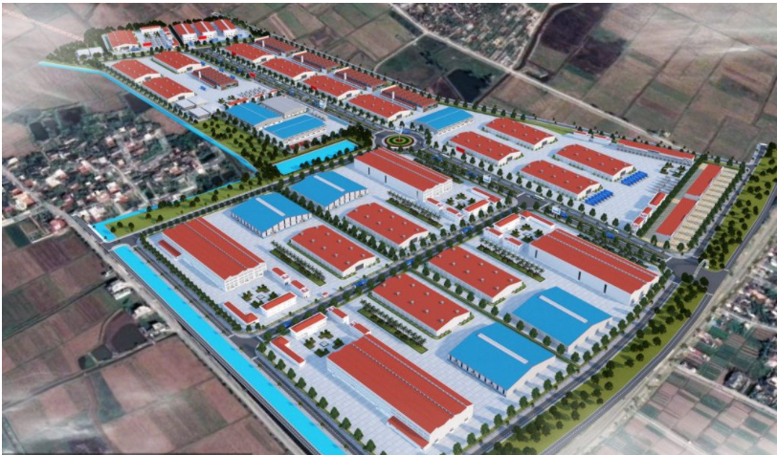
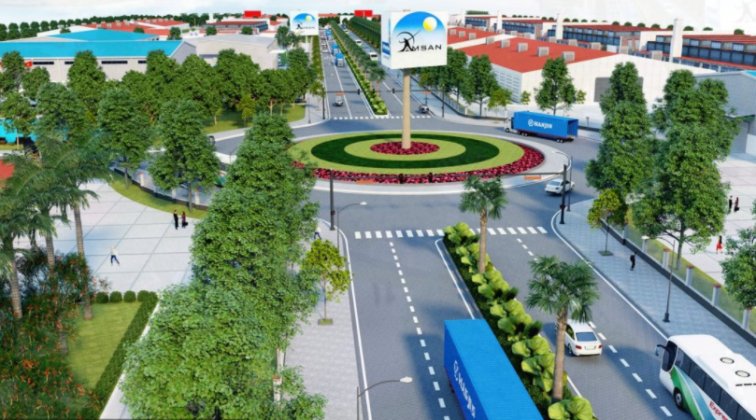
II. COMPANY OVERVIEW (Cont)
5. INDUSTIAL REAL ESTATE
OPERATIONPROJECT
AN NINH INDUSTRIAL ZONE, TIEN HAI DISTRICT, THAI BINH PROVINCE
Location | An Ninh commune, Tien Hai district, Thai Binh province. Convenient to commune along road 37b, 17km from Thai Binh city center and 55km from Hai Phong port
Overview | Industrial Land: 374,415 sq. m; Transportation: 59,477.7 sq. m; Green space and water surface: 49,887.5 sq. m; Technical infrastructure (Waste water treatment): 2,500 sq. m Administration and service land: 12,427.8 sq. m..
Land Area | 498,708 sq. m
Operation since | 10/2021
| Presentation
Notes:
Yêu cầu cho thông tin dự án: quy mô, bàn giao, dthu dự kiến đóng góp

Slide 11
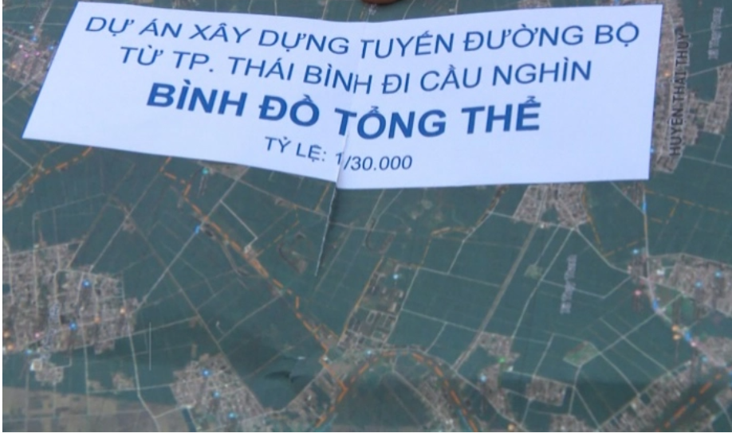
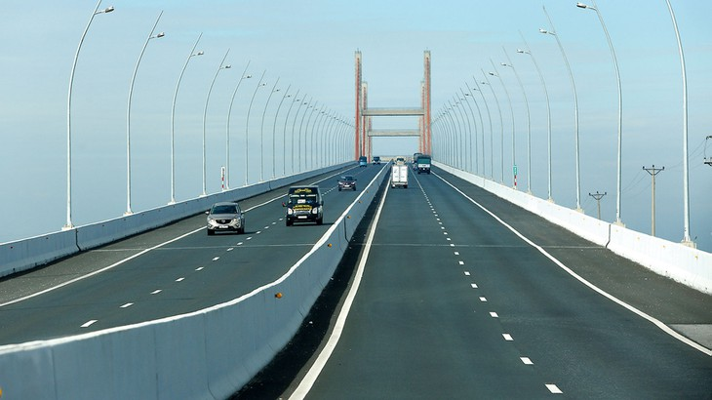
II. COMPANY OVERVIEW (Cont)
6. BOT PROJECTS
UNDER DEVELOPMENT
ROAD CONSTRUCTION PROJECT FROM THAI BINH CITY TO NGHIN BRIDGE
Cooperation | Construction Corporation No. 1 - Lam Son Thai Binh Joint Stock Company – Damsan Joint Stock Company - Phu Thanh Group Joint Stock Company
Overview | The project is invested in the form of a public-private partnership (PPP), a Build-Operate-Transfer (BOT) contract Payback period from the collection of road user service fees is expected to be approximately 23 years (from 2023 to 2046).
Invesment Capital | 2,586.8 billion VND, in which capital from join venture is 1,807 billion VND
Expected completion date | 2021 - 2023
| Presentation
Notes:
Yêu cầu cho thông tin dự án: quy mô, bàn giao, dthu dự kiến đóng góp

Slide 12
PART III: FINANCIAL HIGHLIGHTS
| Presentation

Slide 13
III. FINANCIAL HIGHLIGHTS
Target (Billions dong) | 2018 | 2019 | 2020 | 2021 | 9M2022 | Increase/ Decrease (%)
Current Assets | 1,278 | 1,360 | 1,519 | 1,605.9 | 1.553,92 | (3,2)
Cash & Cash equivalents | 31 | 30 | 37 | 127 | 41.6 | (67,3)
Short – term investments | 320 | 312 | 334 | 272 | 317.4 | 16,7
Short-term receivables | 506 | 624 | 664 | 615 | 746.7 | 21,6
Inventories | 400 | 388 | 475 | 568 | 437.9 | (23)
Other current assets | 20 | 8 | 10 | 24 | 10.4 | (57,6)
Long – term Assets | 435 | 373 | 319 | 379 | 508.88 | 34,2
Long – term receivables | - | - | - | - | - | -
Fixed assets | 391 | 331 | 274 | 225 | 195.84 | (12,9)
Long-term assets in progress | 1 | - | 1 | 0,91 | 1.6 | (19.9)
Long – term investments | 32 | 32 | 33 | 140 | 300.2 | 114,3
Other Long – term assets | 12 | 9 | 11 | 12 | 11.3 | (9,1)
Total Assets | 1,713 | 1,733 | 1,838 | 1,985 | 2.062.8 | 3,9
Liabilities | 1,261 | 1,330 | 1,416 | 1,401 | 1.409.5 | 0,6
Short-term liabilities | 1,119 | 1,217 | 1,318 | 1,299 | 1.229.7 | (41,2)
Short-term loans | 660 | 677 | 668 | 627 | 626.3 | (0,1)
Long-term liabilities | 132 | 113 | 98 | 102 | 179.8 | 76,6
Long – term loans | 142 | 113 | 98 | 100 | 83.4 | (16,5)
Owner’s Equity | 452 | 403 | 422 | 584 | 653.79 | 12,0
Total Resources | 1,713 | 1,733 | 1,838 | 1,985 | 2.062.8 | 3,9
Target (Billions Dong) | 2018 | 2019 | 2020 | 2021 | 9M2022 | Change (y-o-y)
Net Revenue | 1,839 | 1,705 | 1,339 | 1,513 | 1.328 | 29%
Gross Profit | 130 | 57 | 64 | 177 | 121 | 1%
Operating profit | 54 | 7 | 14 | 109 | 73 | (9%)
Profit before tax | 62 | 10 | 28 | 113 | 74.9 | (12%)
NPAT | 56 | 8 | 25 | 100 | 66.9 | (10%)
EBIT | 103 | 52 | 72 | 149 | 112.4 | (-1%)
EBITDA | 165 | 112 | 124 | 209 | 133.65 | (0.7%)
| Presentation
Notes:
Yêu cầu cho thông tin dự án: quy mô, bàn giao, dthu dự kiến đóng góp

Slide 14
III. FINANCIAL INFORMATION (Cont)
| Presentation
Notes:
Yêu cầu cho thông tin dự án: quy mô, bàn giao, dthu dự kiến đóng góp

Slide 15
IV. STOCK SNAPSHOT
Shareholders structure
(at 30/09/2022)
Stock Symbol | ADS
Exchange | HOSE
Outstanding shares | 43,779,034
At June /2021
Share price (VND) | 19.500
Market Capitalization (USD million) | 564.75
Book value Q3 2021 (VND) | 14,935
The highest price in 12M (VND) | 39.100
The lowest price in 12M (VND) | 11.700
Average trading volume in 12M (shares) | 585,208
Foreign ownership limit | 50%
Foreign shareholder ownership | 1,55%
Stock performance
EPS 12M (VND) | 2.952
P/E (times) | 4.3
P/B (times) | 0.85
| Presentation
Notes:
Yêu cầu cho thông tin dự án: quy mô, bàn giao, dthu dự kiến đóng góp

Slide 16
DISCLAIMER
The content presented in this Presentation is only for the purpose of disclosing information to Shareholders and Investors as an overview of ADS. We always try to ensure this information is obtained from reliable sources and the data updated on this Presentation is always up-to-date.
Analyzed statements are based on accurate information in our possession and are reasonable in our opinion under current conditions and non-sensitive information is published in this Presentation. This should not be viewed as a recommendation to buy or sell ADS stock.
ADS will not be liable for any damages incurred as a result of using the content in this Presentation for investment purposes. This presentation is the property of ADS, no one may copy, reproduce, distribute or redistribute for any purpose without the consent of ADS.
Thank you & Best Regards.
FOR FURTHER INFORMATION
DAMSAN JOINT STOCK COMPANY
Lot A4 – Bui Vien Street– Nguyen Duc Canh IZ– Thai Binh City
Administrative Office: +84.2273.643.826
Website: http://damsanjsc.vn/
Email: ir.dir@damsanjsc.vn
| Presentation
Notes:
Yêu cầu cho thông tin dự án: quy mô, bàn giao, dthu dự kiến đóng góp

